Slide 1
Thermostat Filtering for Anticipation
Dave Gutz 27-Jan-2016

Slide 2
Simulink Model

Slide 6
Callback Contents
%PreLoadFcn
OAT=30;
Temp=68;
Rn=29;
Rx=69;
Tn=180;
Tx=120;
Hc=114/86400;
Ha=1.61/86400;
%Hf=1.08/86400;
Hf=1.745/86400;
Ho=283/86400;
tau=40;
FILTER_DELAY = 5;
K2=1;
K3=1;
Ki=1e-5;
Kp=2;
Kd=800;
Kf=1;
compGain=400; % gain in TCOMP of house control
Kei=Ki*2;
Kep=Kp*2;
Qfire=0;
% InitFcn
Ta0=Temp;
Tw0 = (Temp*Ha + OAT*Ho)/(Ho+Ha);
Tb0=max(min(interp1([Rn Rx],[Tn Tx],OAT), Tn),Tx);
Tc0 = ((Ha+Hc)*Ta0 - Ha*Tw0) / Hc;
D0 =max(min( Hc*(Tc0-Ta0)/(Hf*(Tb0-Tc0)), 1), 1e-32);

Slide 7
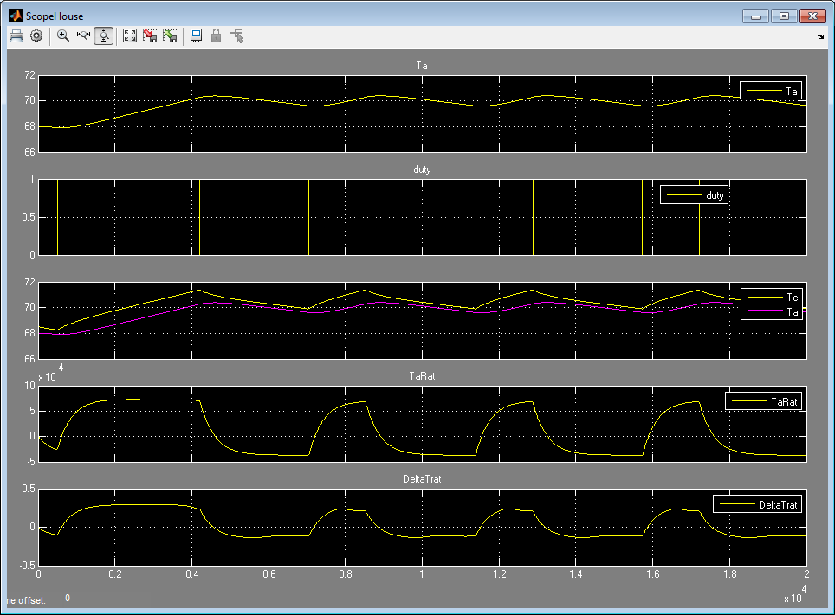

Slide 8
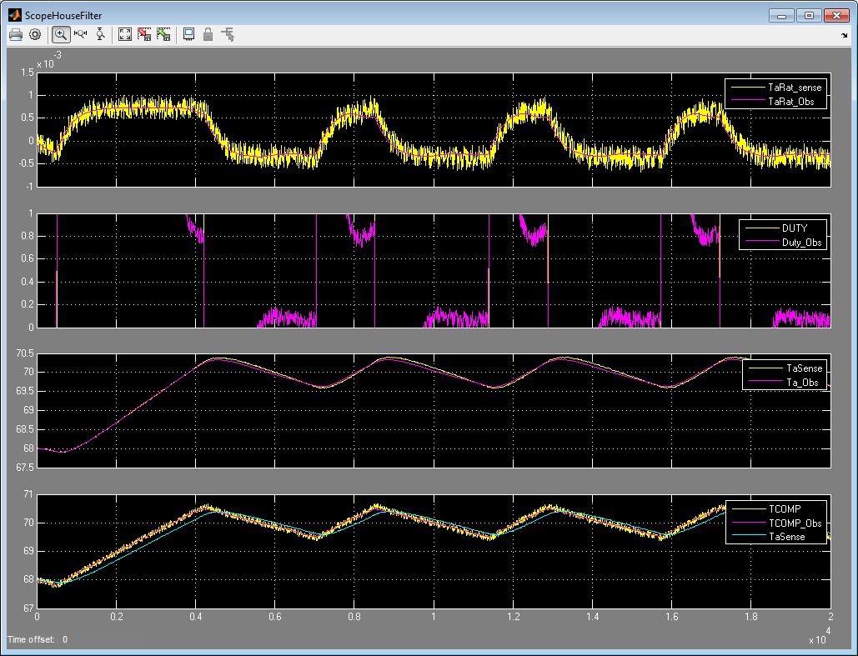

Slide 9
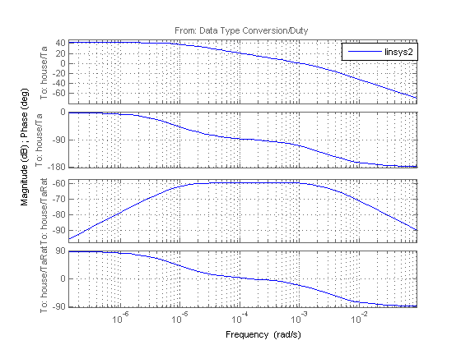
8e-6 r/s
3e-3 r/s

Slide 10
Use divider slides to separate different sections of your pitch

Slide 11
Use divider slides to separate different sections of your pitch

Slide 12
Use divider slides to separate different sections of your pitch

Slide 13
Colors in this template (RGB)
R- 30
G- 65
B- 145
R- 0
G- 170
B- 80
R- 255
G- 102
B- 0
R- 155
G- 80
B- 212
R- 40
G- 185
B- 245
R- 118
G- 185
B- 0
R- 238
G- 51
B- 36
R- 235
G- 215
B- 10
Abc123
ABC123
Abc123
ABC123
Abc123
ABC123
Abc123
ABC123
Abc123
ABC123
Abc123
ABC123
Abc123
ABC123
Abc123
ABC123

